Slide 1
MIRIAM WAIRIMU MAINA C027-01-2596/2021 CLOUD COMPUTING IN THE FIELD OF BBIT
HOW CLOUD COMPUTING IS TRANSFORMING THE WAY BBIT STUDENTS LEARN AND WORK

Slide 2
INTRODUCTION
Cloud computing is the delivery of computing services—including servers, storage, databases, networking, software, analytics, and intelligence—over the Internet ("the cloud") to offer faster innovation and flexible resources.
Cloud computing is important for BBIT students and professionals because it is a rapidly growing field with a high demand for skilled workers. It is also transforming the way that businesses operate, and BBIT students and professionals who have cloud computing skills will be well-positioned for success in the future job market.
Cloud providers offer a wide range of cutting-edge technologies, such as artificial intelligence, machine learning, and big data analytics. BBIT students and professionals can use these technologies to develop new and innovative products and services.
There are a wealth of online resources available to help BBIT students and professionals learn about cloud computing. They can learn about cloud computing concepts, technologies, and best practices at their own pace.

Slide 3
HOW CLOUD COMPUTING WORKS.
You sign up for a cloud computing account with a cloud provider.
You choose the resources you need, such as servers, storage, and databases.
You deploy your applications to the cloud provider's infrastructure.
You access your applications and data over the internet.
The cloud provider is responsible for managing and maintaining the infrastructure that supports your applications and data hence one should not be worried about things like hardware failure, software updates, or security patches.
The key features of cloud computing are:
Broad network access: Cloud computing services are accessible over the internet, from anywhere in the world.
Rapid elasticity: Cloud computing resources can be scaled up or down quickly and easily, to meet changing demand.
Resource pooling: Cloud providers pool their computing resources to serve multiple customers. This allows them to use their resources more efficiently and to offer lower prices to customers.
Cloud computing platforms facilitate collaboration among students and professionals. They can share files, resources, and ideas in real time, regardless of their location.

Slide 4
APPLICATIONS OF CLOUD COMPUTING IN BBIT
Education:
Online learning: Cloud computing can be used to deliver online courses and learning materials to students anywhere in the world.
Collaboration: Cloud computing platforms can facilitate collaboration among students and professors, making it easier to share files, resources, and ideas.
Research: Cloud computing can provide researchers with access to powerful computing resources and data storage solutions, enabling them to conduct complex research projects.
Business:
Web hosting: Cloud computing can be used to host websites and web applications at a lower cost than traditional on-premises solutions.
Data storage and analysis: Cloud computing platforms offer scalable and secure storage solutions for data, as well as powerful tools for data analysis and visualization.
IT infrastructure management: Cloud computing platforms offer a wide range of IT services, such as computing, storage, networking, and databases. This can help businesses to reduce their IT costs and complexity

Slide 5
CLOUD COMPUTING IN EDUCATION
A recent case study published by the National Institute of Education Sciences (NIES) found that cloud-based learning platforms can help to improve student achievement. The study found that students who used cloud-based learning platforms outperformed their peers who used traditional on-premises learning solutions on standardized tests.
Cloud-based learning platforms are improving education for BBIT students in a number of ways:
Providing access to high-quality learning materials - they provide BBIT students with access to high-quality learning materials, such as online courses, e-books, and video tutorials that can help BBIT students to develop the skills and knowledge they need to succeed in their careers.
Preparing BBIT students for the future of work – it does this by teaching them the skills they need to succeed in the digital economy. BBIT students can use cloud-based learning platforms to learn about cloud computing, artificial intelligence, machine learning, and other emerging technologies.
Supporting personalized learning: Cloud-based learning platforms support personalized learning by allowing BBIT students to learn at their own pace and in their own way.

Slide 6
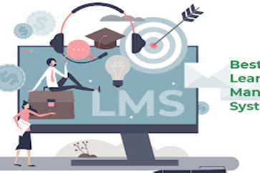
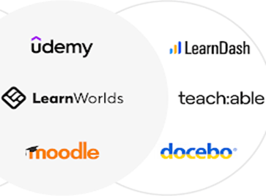
Examples of Cloud-Based Learning Platforms
Canvas
Canvas is a popular cloud-based learning platform that is used by educational institutions of all sizes. Canvas offers a variety of features and tools, including online courses, quizzes, assignments, and discussion forums.
Moodle
Moodle is an open-source cloud-based learning platform. Moodle offers a variety of features and tools, including online courses, quizzes, assignments, and discussion forums.
Google Classroom
Google Classroom is a cloud-based learning platform that is integrated with other Google products, such as Google Docs, Google Sheets, and Google Slides. Google Classroom makes it easy for students and teachers to collaborate on assignments and projects.
Canvas cloud based learning platform
Moodle cloud based learning platform

Slide 7
CLOUD COMPUTING IN RESEARCH.
Cloud-based research platforms are helping BBIT students and professionals conduct research in a number of ways:
Supporting data-intensive research: Cloud-based research platforms provide BBIT students and professionals with the storage and computing resources they need to conduct data-intensive research. Cloud-based research platforms can also be used to analyze large datasets and create visualizations.
Accelerating the research process: Cloud-based research platforms can help BBIT students and professionals to accelerate the research process by providing them with access to powerful computing resources, data storage, and collaboration tools.
Facilitating collaboration: Cloud-based research platforms facilitate collaboration among BBIT students and professionals. BBIT students and professionals can use cloud-based research platforms to share data, code, and results with their collaborators

Slide 8
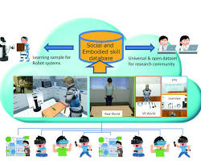
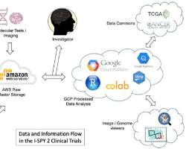
Examples of Cloud-Based Research Platforms
Kaggle
Kaggle is a cloud-based platform for data science and machine learning. Kaggle offers a variety of features and tools that can be used for research purposes, such as data storage, computing, and collaboration tools
Amazon Web Services (AWS)
AWS offers a wide range of cloud-based services that can be used for research purposes, including computing, storage, networking, databases, analytics, machine learning, and artificial intelligence.
ResearchGate
ResearchGate is a cloud-based platform for researchers to share their work and collaborate with other researchers. ResearchGate offers a variety of features and tools, such as paper publishing, social networking, and data sharing tools.
Kaggle cloud based research platform
Amazon Web Services (AWS) cloud base

Slide 9
CHALLENGES OF CLOUD COMPUTING ADOPTION
Security - Cloud providers are responsible for the security of their infrastructure, but customers are responsible for the security of their data and applications. This can be a challenge for organizations that do not have the expertise or resources to manage cloud security effectively.
Privacy - Cloud providers collect a lot of data about their customers, including usage data, billing data, and customer information. This data can be used to track customer activity and build detailed profiles of customers. Organizations need to be careful about what data they store in the cloud and how they use that data
Compliance - Organizations need to comply with a variety of regulations, such as data privacy regulations, financial regulations, and healthcare regulations. Cloud providers need to be able to help organizations comply with these regulations

Slide 10
THE FUTURE OF CLOUD COMPUTING IN BBIT
Cloud computing in education could be used to develop personalized learning experiences for students, provide students with access to the latest technologies and resources, facilitate collaboration between students and instructors from around the world and Make education more accessible and affordable for students from all backgrounds.
Cloud computing in business could be used to develop new cloud-native BBIT applications, use artificial intelligence and machine learning to automate BBIT tasks, provide services to customers on a global scale and make businesses more agile and responsive to change.
Emerging Applications of Cloud Computing in BBIT
Edge computing: Edge computing is a distributed computing paradigm that brings computation and data storage closer to the devices where data is generated and consumed. Cloud computing can be used to support edge computing by providing a platform for managing and deploying edge applications.
Quantum computing: Quantum computing is a new type of computing that uses the principles of quantum mechanics to perform calculations. Cloud computing can be used to provide access to quantum computing resources to BBIT businesses and researchers.
Digital twins: Digital twins are virtual representations of physical objects or systems. Cloud computing can be used to develop and deploy digital twins for a variety of BBIT applications, such as product design, manufacturing, and maintenance

